Slide 1


Graphs: static vs. interactive
Let’s introduce plotly (website)
This is an alternative graphing library to ggplot
The advantage: its graphs are interactive
You can pan, move and zoom on the graph
Hovering with the mouse over a data point can give information about it (position, group…), or additional information of your choosing.
The easiest way to use is to create a ggplot graph first, then to use the ggplotly() function on it.
This will make the graph interactive

Slide 2
Graphs: static vs. interactive
Great in the context of interactive tools (e.g. dashboards)
Useless for written reports, and for most presentations
You’re better off using ggplot, you will find more documentation and additional packages for it

Slide 3
3D plots
Plotly offers the possibility of creating 3D plots
Interactive examples here
Easy to do: you can specify a z variable in the plot_ly() function
It is hard to read though (because you must manipulate the cube), and of course because it must be interactive to be understood, this limits its usages
Maybe only consider a 3D graph when a 2D graph cannot give enough information

Slide 4
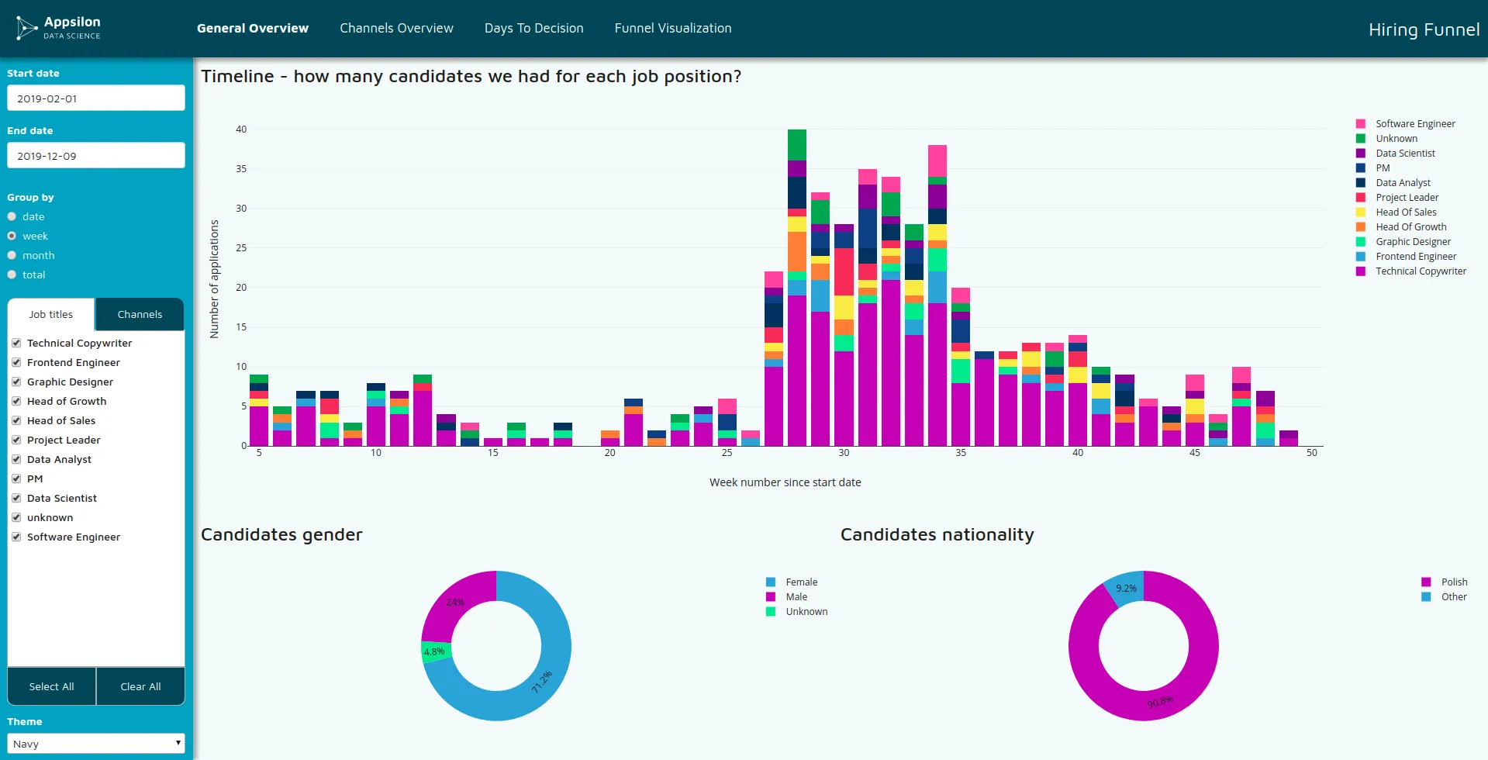
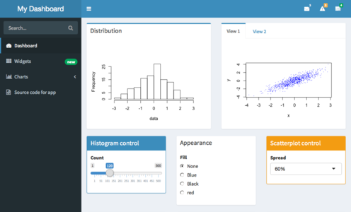
Dashboards
A dashboard is an interactive tool you use for data visualization. Imagine a webpage on which you have/can do:
Interactive tables for which you can select variables you want to show
Interactive graphs and maps on which you can zoom, get tooltips when your cursor hovers a data point
Filter the dataset on the fly
Even let the user use a regression model for which they can choose covariates

Slide 5
Dashboard inspiration
Again, looking at other dashboard is how will you get inspired to try new things with your dataviz
Here: https://shiny.posit.co/r/gallery/

Slide 6
Why dashboards? And when?
Entry cost can be high
Intermediate level technical know-how if you code it: need to know specific R/Python packages, and ideally HTML/CSS (even better if you know Javascript)
Time consuming to prepare
If you choose to buy a dashboarding software, money might be the issue
But, it allows more exploratory approaches
Clients/stakeholders/decision makers can look at the data themselves
If they have questions, and your dashboard is flexible enough, you may answer their questions directly in the meeting with your tool
Usually, people love this
Again: PEOPLE. LOVE. THIS.

Slide 7




The paid ones
Above: Tableau, PowerBI, QlikSense, Looker
There are many, many others
There are free versions if you want to learn one of them
DON’T PAY FOR THEM
Maybe learn one, and if you work on others they will feel at least a bit intuitive
To my knowledge, there is no “big one” that is used everywhere

Slide 8



The free, flexible ones (i.e. the good ones)
Above: Shiny (R), Streamlit (Python), Dash (Python)
For R, virtually every dashboard is done using Shiny
There are also others for Python: Shiny, Holoviz…
Python will offer more package variety: it’s more of a “general-purpose” language than R, and its been used in web development for a while (e.g. Django)

Slide 9
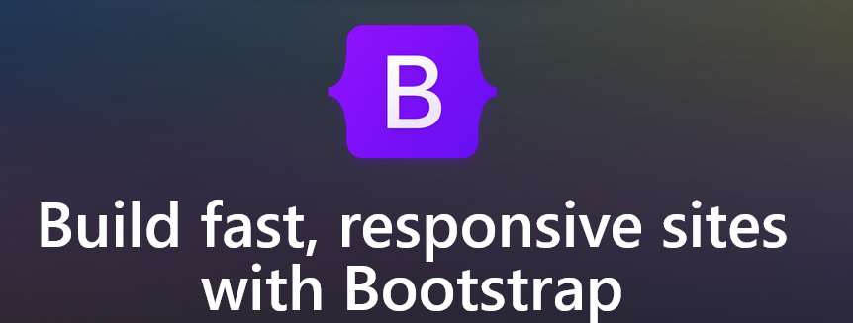
We will do some Shiny this afternoon
This is a package developed by RStudio (Posit PBC, now) since 2012
There is a book about it (Mastering Shiny) by Hadley Wickham, a key person at Posit and one of the developers of the tidyverse
It’s a web framework: with it, you can create a web application
It’s mainly known for dashboards, but it is somewhat versatile
You could create a web application in which you do all your statistical modelling for example (it won’t be as good as programming this in R though)
Gallery for inspiration: https://shiny.posit.co/r/gallery/
There are add-ons that build upon it, I personally use bslib a lot
https://nz-stefan.shinyapps.io/commute-explorer-2/
Notes:
Now, it is not a full fledged web framework, you won’t build complicated web applications with it. But it’s not like you are studying data science to be a web developer, so this will do.

Slide 10
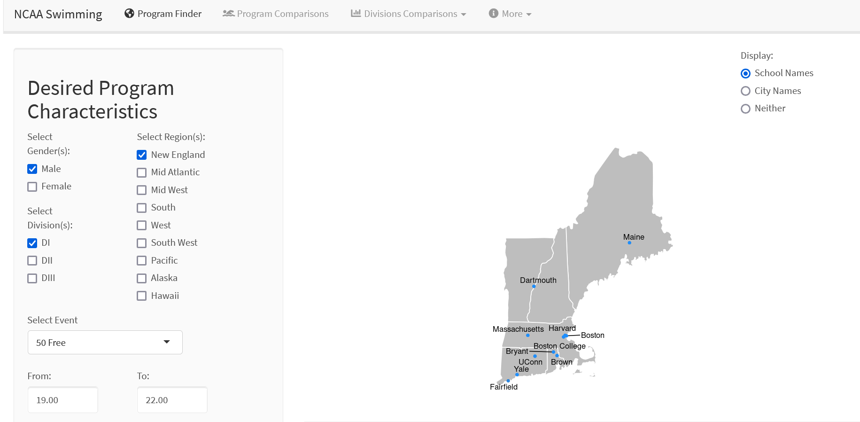
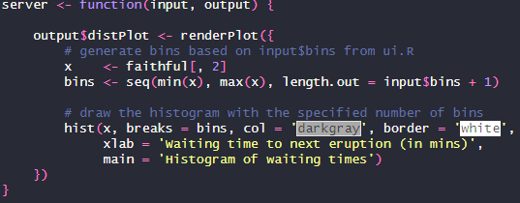
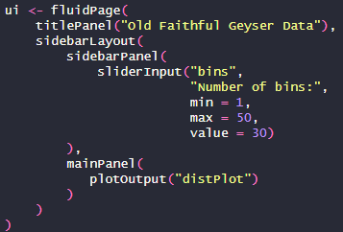
Front-end and back-end
A Shiny application has two parts:
Front end
(User interface)
Back end
(server)
Notes:
So the front end is where you decide what the user sees, what he can do or modify or click on. You define the layout of the web application, the buttons, sliders, what visualisations you include…
The back end is where you decide what content populates each element in the front end. What goes inside each graph, table, what data each slider refers to, etc. etc.

Slide 11
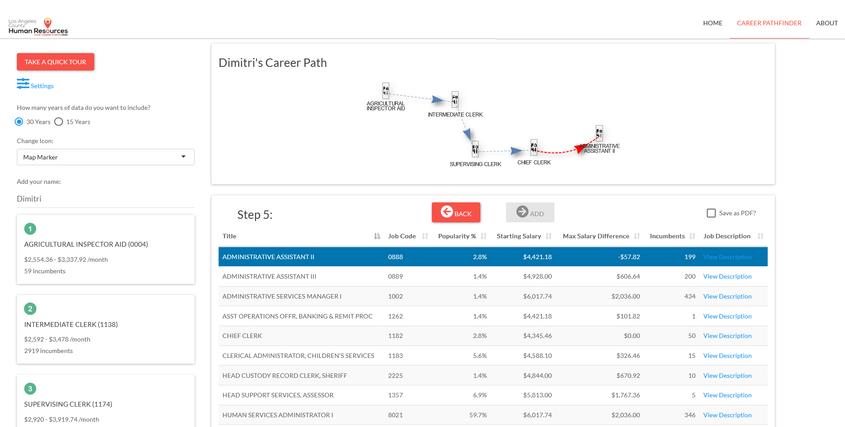
Front-end - Layout
Navbar (top or bottom) ➔ Title/logo + pages
The navbar and sidebar are facultative
If you change want a single page, this is possible
Body ➔ You put your content there
Sidebar (left or right, or both) ➔ Usually settings, parameters

Slide 12
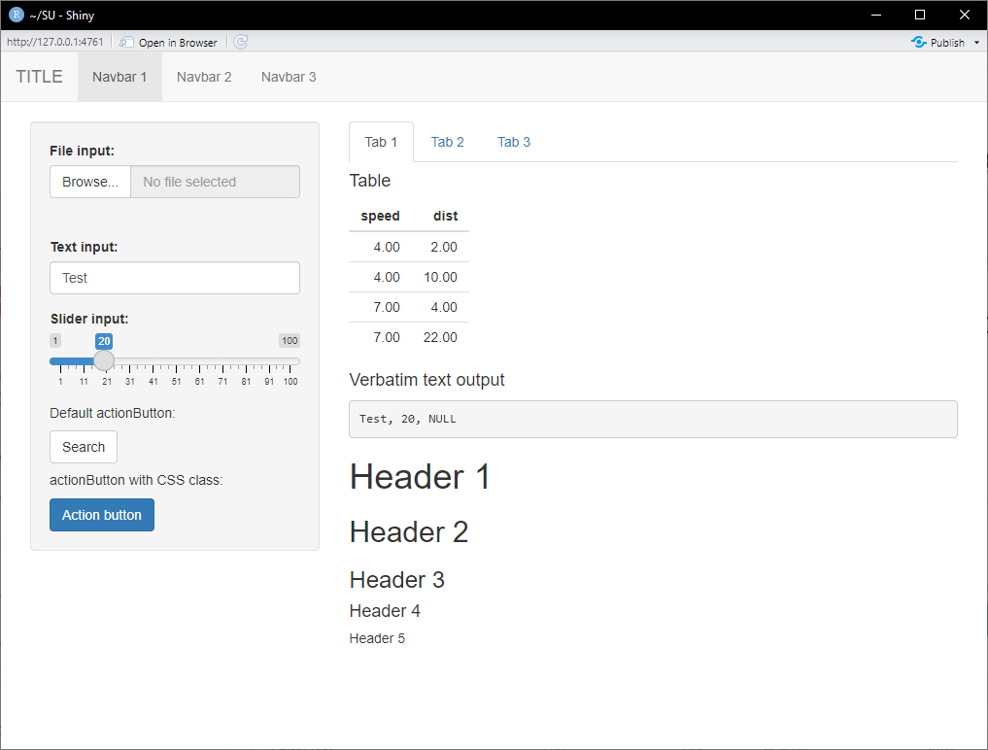
Front-end – Components
You can fill your pages with texts, headers, images, graphs, tables…
You also have the possibility of defining parameters (see sidebar), they will allow for reactivity
These are inputs
They take the form of sliders, buttons, drop down menus…
These are outputs
Usually tables and graphs

Slide 13
Front-end
Back-end
In the server side, we say what goes into each element defined in front-end. In table_1, we put a dataframe called df
output$table_1 <- renderDT({df})
This table here has an output id: table_1 (for example).
dataTableOutput(outputId = "table_1")

Slide 14
Reactivity
Back-end
In the server side, we can use the inputs to impose some conditions. For example, in table_1, if we wanted to only see values of speed below the value of slider_1.
We define a reactive object (it gets automatically updated when an input changes)
df_reactive <- reactive({
df %>% filter(x <= input$slider_1)
})
This input here has an input id: slider_1 (for example).
We then use this reactive object to populate the output element called table_1
output$table_1 <-
renderDT({df_reactive()})

